Slide 1





Thank you to our Global Sponsors and Supporters

Slide 2

We are thrilled to say the first ever PASS Virtual Summit will be taking place this November!
We will be launching PASS Summit into a whole new world, and with that comes exciting opportunities with what we can offer you. We will go beyond simply moving sessions online to fully embracing everything a virtual environment can offer.
Find out more at PASS.org/summit - Utah County SQL Group discount code - LGDIS6I0T ($50 off registration)

Slide 3
Session Evaluations
https://www.sqlsaturday.com/997/Sessions/Session-Evaluation
Alternatively go to the Schedule and click on the session you would like to give feedback on and click Session Evaluation

Slide 4
Utah Geek Events slack channels for attendees to chat
To get an invite to the Slack Space
http://bit.ly/2bm3vwW
Channels
#sqlsaturday997_room1
#sqlsaturday997_room2
#sqlsaturday997_room3
#sqlsaturday997_room4

Slide 5
997 Salt Lake City - Aug 29, 2020
notebooks 101 for SQL people
why notebooks?
azure data studio 💙 notebooks
learn more
give it a go: aka.ms/AzureDataStudio

Slide 6

hi!

Slide 7

Julie Koesmarno
Principal Program Manager at Microsoft
jukoesma@microsoft.com | MsSQLGirl.com | @MsSQLGirl
Current projects in Azure Data Studio:
Notebook Scenarios & Ecosystem
Machine Learning Extension in Azure Data Studio

Slide 8
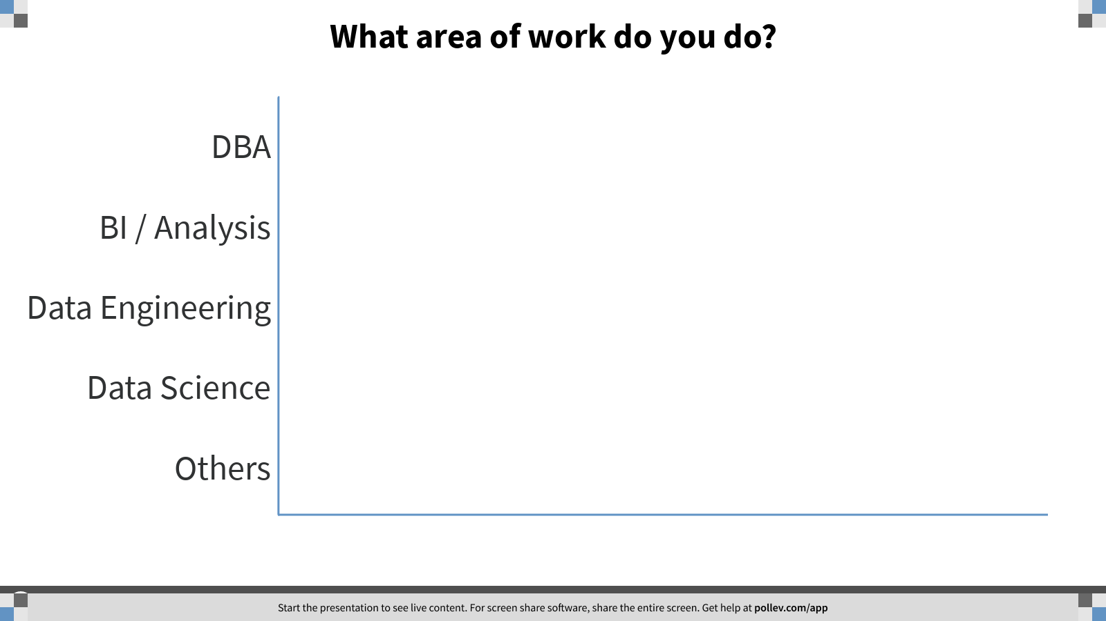

Notes:
Poll Title: What area of work do you do? https://www.polleverywhere.com/multiple_choice_polls/3rvj2WZvV3sntLHmuxgYH

Slide 9
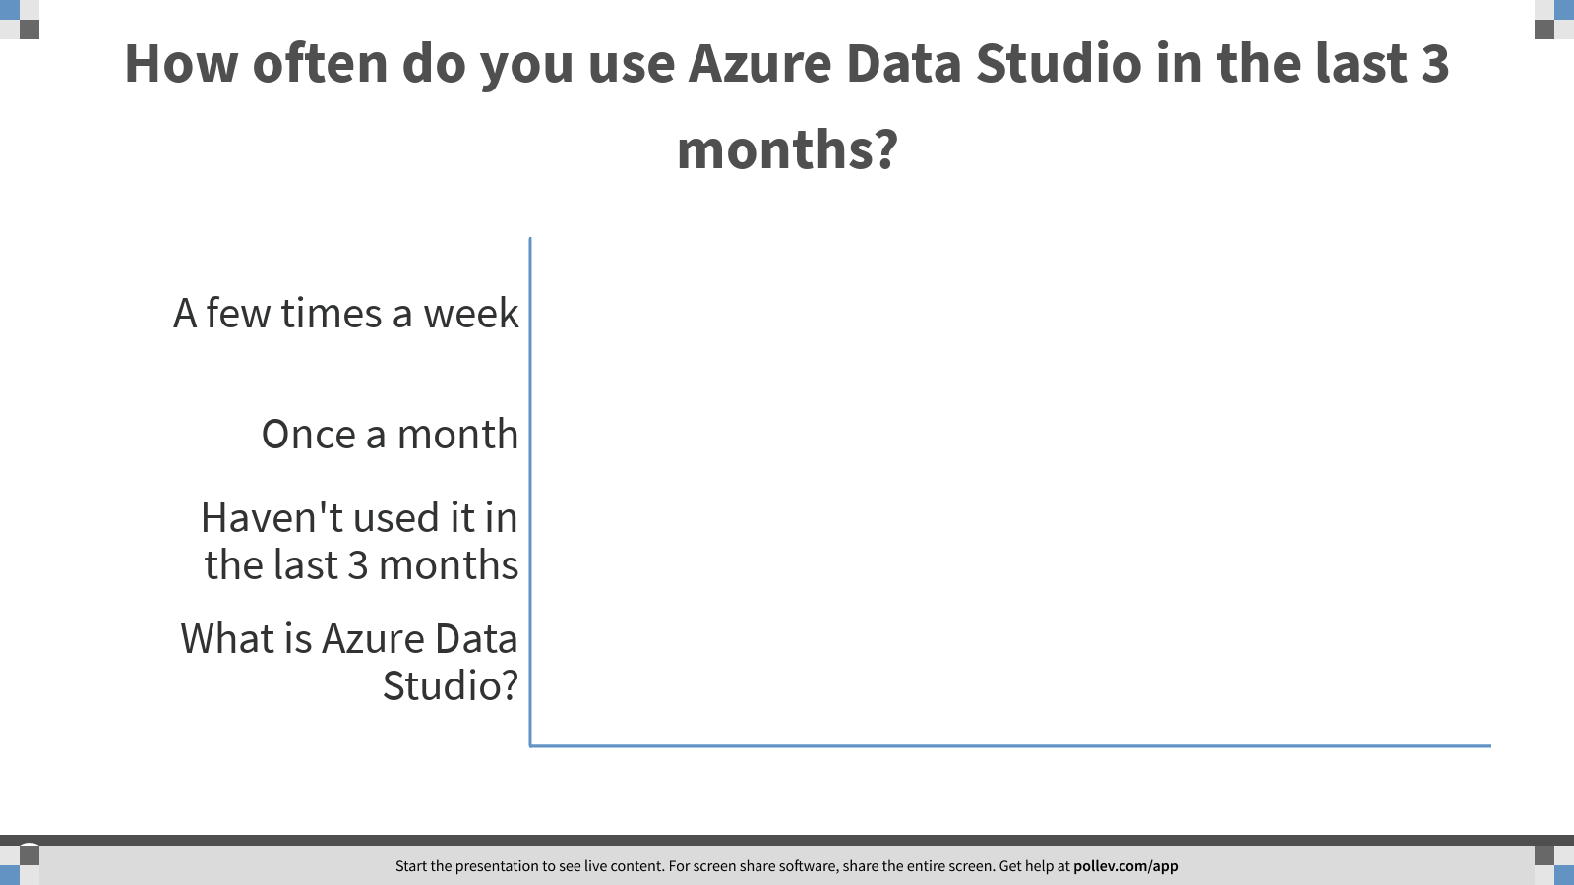
Notes:
Poll Title: How often do you use Azure Data Studio in the last 3 months? https://www.polleverywhere.com/multiple_choice_polls/mrGoN9kbzvHST3ApEfUWT

Slide 10
1. why notebooks?

Slide 11

once upon a time …

Slide 12



--
-- Prepared by Cookie Monster
-- 2020.03.01
-- Question from Marketing about how much we sell and what's the shorter manufacturing time.
--
SELECT TOP 10 *
FROM Production.Product
ORDER BY Name ASC;
I need to know which product has the fastest turnaround ..
Let me query that!
Here you go…
Oh.. I need the product category..
-- Get Product list and product category with fast manufacture days
USE AdventureWorks2017;
GO
SELECT
c.Name AS ProductCategory
, p.Name as ProductName
, p.ProductNumber
, p.ListPrice AS Price
, p.DaysToManufacture
FROM Production.Product p
INNER JOIN Production.ProductSubcategory s
ON s.ProductSubcategoryID = p.ProductSubcategoryID
INNER JOIN Production.ProductCategory c
ON c.ProductCategoryID = s.ProductCategoryID
WHERE p.DaysToManufacture < 4
GO
-- Get Product List with fast manufacture days.
SELECT
p.Name as ProductName
, p.ProductNumber
, p.ListPrice AS Price
, p.DaysToManufacture
FROM Production.Product p
WHERE p.DaysToManufacture < 4
GO
Sure..
Here you go again…
1
Thanks! This is for the last quarter, right?
Do you mean sold products?
2

Slide 13

-- Get Product list and product category with fast manufacture days
USE AdventureWorks2017;
GO
SELECT
c.Name AS ProductCategory
, p.Name as ProductName
, p.ProductNumber
, p.ListPrice AS Price
, p.DaysToManufacture
FROM Production.Product p
INNER JOIN Production.ProductSubcategory s
ON s.ProductSubcategoryID = p.ProductSubcategoryID
INNER JOIN Production.ProductCategory c
ON c.ProductCategoryID = s.ProductCategoryID
WHERE p.DaysToManufacture < 4
AND EXISTS (SELECT TOP 1 1
FROM Sales.SalesOrderDetail sod
INNER JOIN Sales.SalesOrderHeader soh
ON soh.SalesOrderID = sod.SalesOrderID
WHERE sod.ProductID = p.ProductID
AND soh.OrderDate BETWEEN '20140101' AND '20140331')
GO
I need to know which product has the fastest turnaround ..
Let me query that!
Here you go…
3
Oh.. I need the product category..
Sure..
Here you go again…
Thanks! This is for the last quarter, right?
Do you mean sold products?
Here you go again…
You are a Rockstar! Thanks.

Slide 14
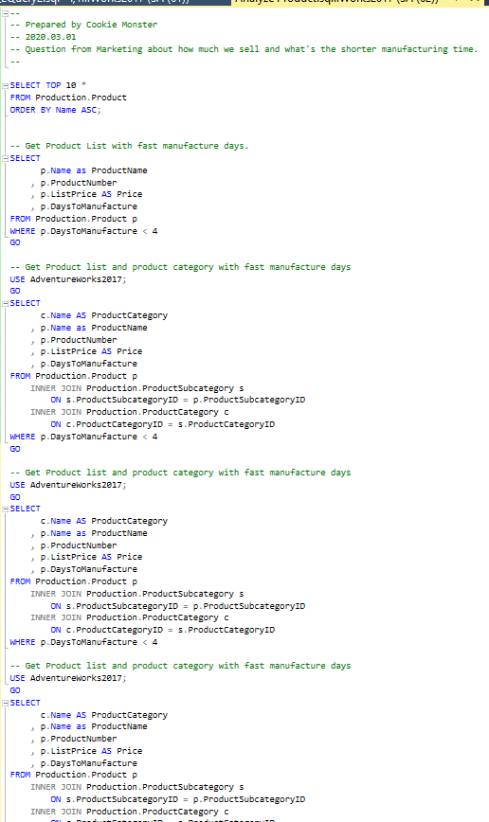
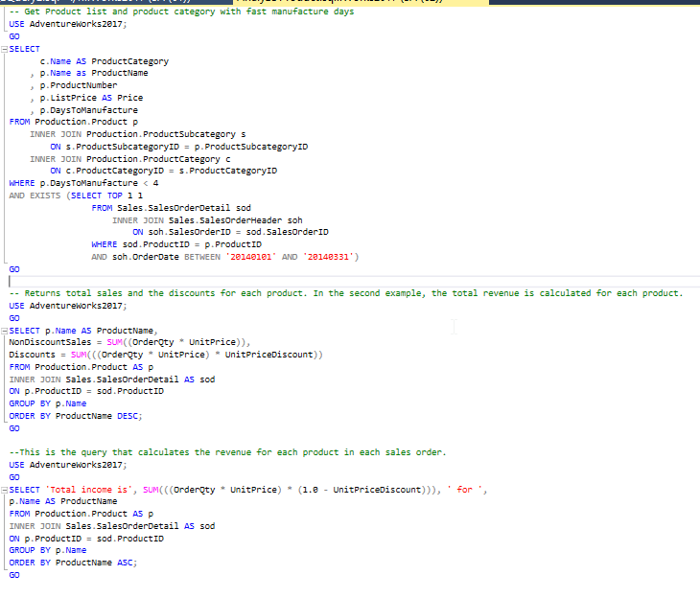
My dirty little scripts in the closet ….

Slide 15

many days later

Slide 16

You know that list that you sent me last time about that fast manufacturer… Can refresh it, please?
PANIC
PANIC
PANIC
What list?
PANIC
Oh.. That list! Yea yea…
Here you go again…
PANIC
I want to compare what the result back then and what it is now; if we have had any changes…
PANIC
PANIC
Was the logic the same as what you did last time?
PANIC
Hello?
PANIC

Slide 17

what’s the problem?

Slide 18
Lack of:
Reproducibility
Code Review
Auditing results / analysis
Context
Executable
Must haves:
Code
Documentation
Results
Visualization
Analysis + Interpretation
Executable

Slide 19
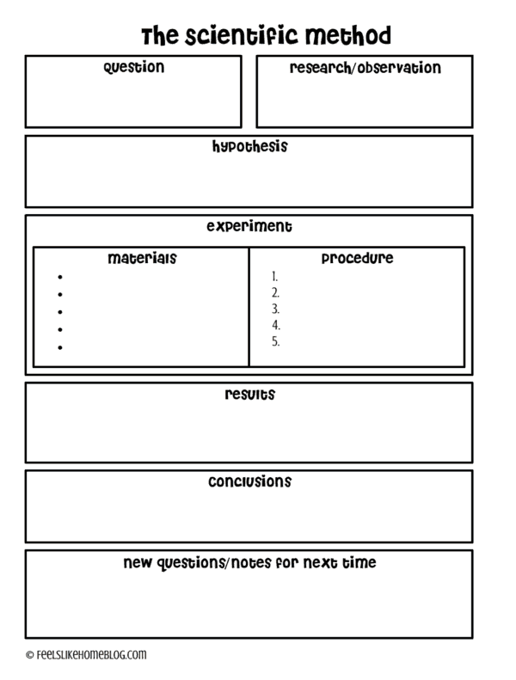

remember School Science Projects?
Source: https://feelslikehomeblog.com/2017/07/the-science-of-slime-its-way-more-than-polymers/

Slide 20

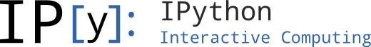
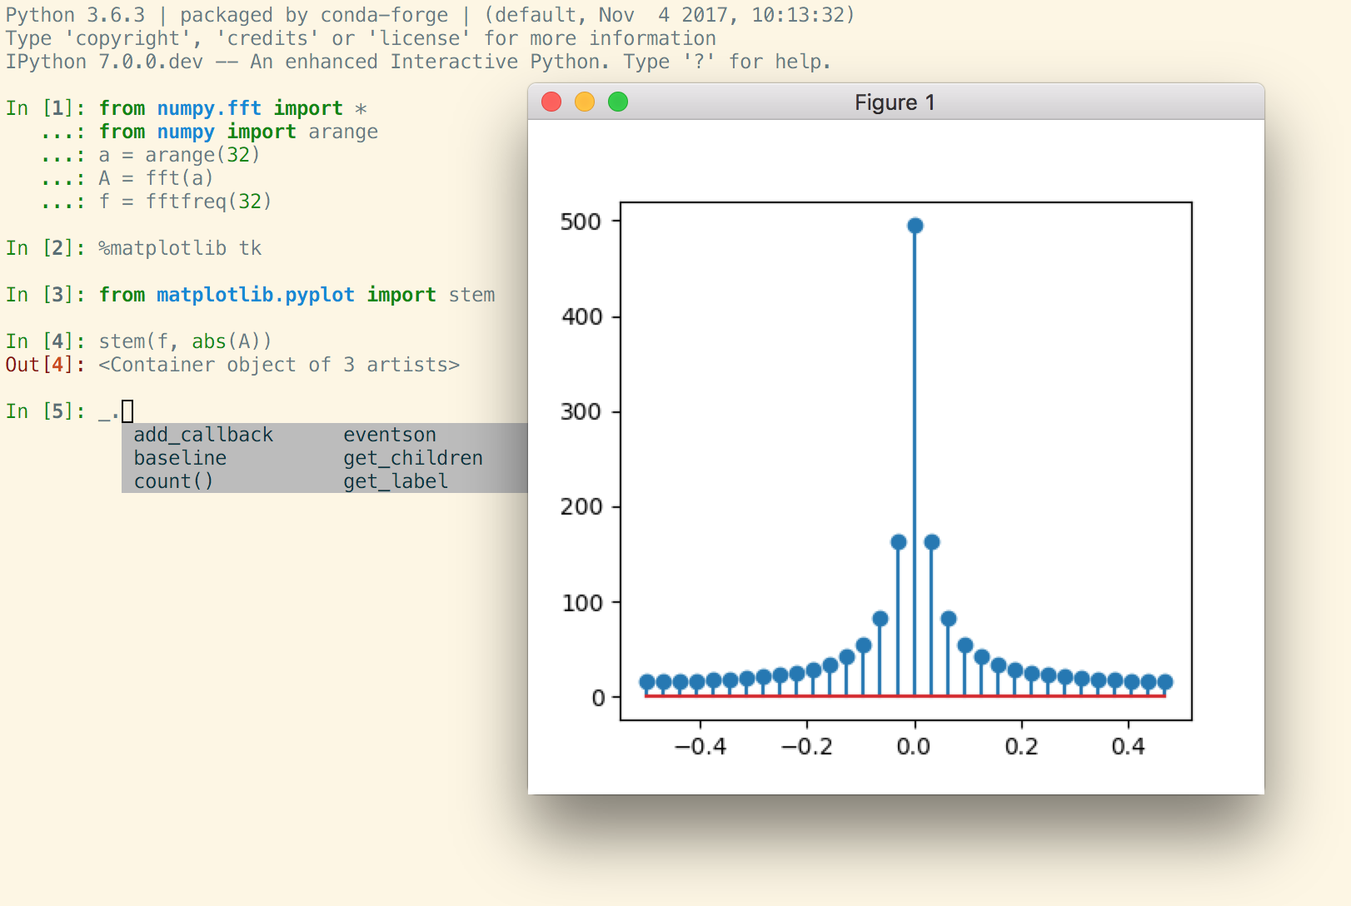

Mostly for Data Science projects
Open Source, open-standards and services for interactive computing for multiple languages – formed in 2015
Command shell for interactive computing – since 2001
Azure Databricks
Azure Notebooks*
VSCode
Azure Data Studio introduced notebooks in 2018 for Data professionals; and specifically for SQL People since 2019
Notebooks Journey

Slide 21
2. azure data studio 💙 notebooks

Slide 22

let’s demo!

Slide 23
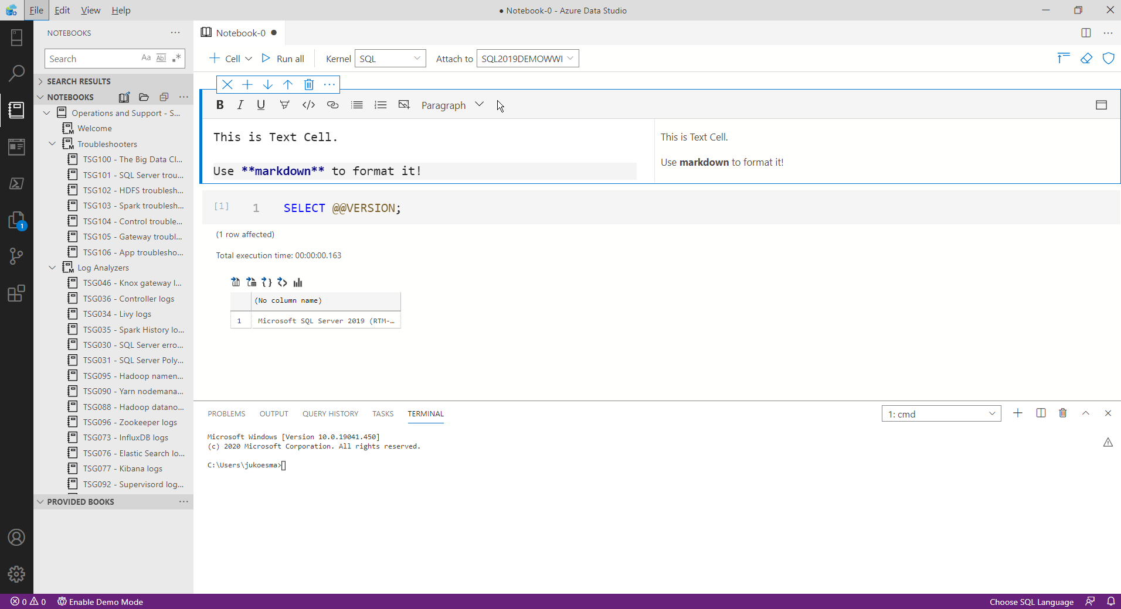
SQL Kernel & Connection
Text Cell
Notebook viewlet
Code Cell
Output

Slide 24
3. learn more …

Slide 25
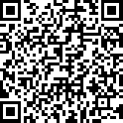
resources
http://aka.ms/AzureDataStudio | Sample files: https://bit.ly/2YGTpAy
SQL Assessment API notebook
https://github.com/microsoft/sql-server-samples/tree/master/samples/manage/sql-assessment-api/notebooks
Glenn Berry’s Diagnostic Notebooks for SQL Server and Azure SQL DB:
https://glennsqlperformance.com/resources/
Rob Sewell’s Notebook
http://sqldbawithabeard.com
Sample notebooks: https://github.com/SQLDBAWithABeard/JupyterNotebooks
The SQL Diagnostic (Jupyter) Book by Emanuele Meazzo
https://tsql.tech/the-sql-diagnostic-jupyter-book/

Slide 26
4. give it a go

Slide 27
key take-aways
Notebooks for SQL people use cases
Reproducible research, aka. Data analysis and data exploration.
Troubleshooting guides for incident response
Tutorial / How-to’s
Data Engineering
Language (Kernel) supported in Azure Data Studio:
SQL
PowerShell
Python
PySpark
Spark Scala
Spark R
Try it out today: http://aka.ms/AzureDataStudio

Slide 28
thank you
Julie Koesmarno | @MsSQLGirl

